Slide 1

Clinical Quality Framework (CQF) and Standards for Quality Improvement: Moving from siloed standards to an interoperable, seamless clinical framework
August 17, 2016
Julia Skapik, MD, MPH
Medical Officer
Office of the National Coordinator for Health IT IT

Slide 2
harmonized qi standards
The Clinical Quality Framework (CQF): Background

Slide 3
Need for Standards Harmonization
The standards used for the electronic representation of CDS and eCQM were not developed in consideration of each other, and used different approaches to patient data and computable expression logic.
 | Patient Data | Computable Expression Logic
Clinical Decision Support (CDS) | Virtual Medical Record (for both physical and logical models) | CDS Knowledge Artifact Implementation Guide
Electronic Clinical Quality Measurement (eCQM) | Quality Reporting Data Architecture (for physical model) Quality Data Model (for logical model) | Health Quality Measure Format (for physical model) Quality Data Model (for logical model)
,
Harmonization of the CDS and eCQM standards was required to reduce implementation burdens, promote integration between these two domains, and facilitate care quality improvement.
Notes:
Goals
To harmonize standards for CDS and eCQM
To harmonize with relevant standards (e.g., CIMI, FHIR) to facilitate widespread adoption
To refine and validate the standards via pilot implementations
Expected Benefits
Reduced implementer burden
Increased re-use of eCQM artifacts in CDS and vice versa
Improved standards quality through unification of community effort

Slide 4
Goal: Shared Standards Clinical Quality Measurement and Clinical Decision Support
Common Metadata Standard
CQM Specific Standards
HQMF
QRDA Category-1
QRDA Category-3
QDM
CDS Specific Standards
HeD
vMR
Common Data Model QUICK/QICore
Common Expression Logic Standard CQL
* Quality Improvement and Clinical Knowledge
** Clinical Quality Language

Slide 5
CQF: Unique Contributions
History of successful harmonization
Flexible, model-agnostic expression language allows use of models to drive action
Existing approach towards model convergence
Deep integration with FHIR and effort to incorporate into the core standard

Slide 6
History of Successful Harmonization : Clinical Quality Metadata Conceptual Model
Metadata is data about data. It is used to classify an information artifact to enable that artifact to be retrieved, used, or quantified.
Prior to this approach, the Clinical Quality Improvement domain included several information models with a total of 18 different HL7 standards with metadata requirements.
The Clinical Quality Metadata Conceptual Model brings together the requirements for many CQI standards/models and harmonizes them into a single conceptual model.
Use cases for Clinical Quality Metadata Conceptual Model:
Health eDecisions (HeD)
Decision Support Services (DSS)
Health Quality Measures Format (HQMF)
Virtual Medical Record (vMR)
Quality Reporting Data Architecture (QRDA)
Templates
Clinical Document Architecture (CDA)
Order Sets
Notes:
February 2015 pub date

Slide 7
CQF: Unique Contributions
History of successful harmonization
Flexible, model-agnostic expression language allows use of models to drive action
Existing approach towards model convergence
Deep integration with FHIR and effort to incorporate into the core standard

Slide 8
Flexible, Model-agnostic Expression Language:
Clinical Quality Language (July 2015)
Notes:
Builds on functional requirements defined in:
Harmonization of Health Quality Artifact Reasoning and Expression Logic
Leverages
Computability achieved by HeD
Measure Author understanding (QDM Heritage)
Focus of the high-level syntax is on authoring
While providing a clear/automatic path to computable logic

Slide 9
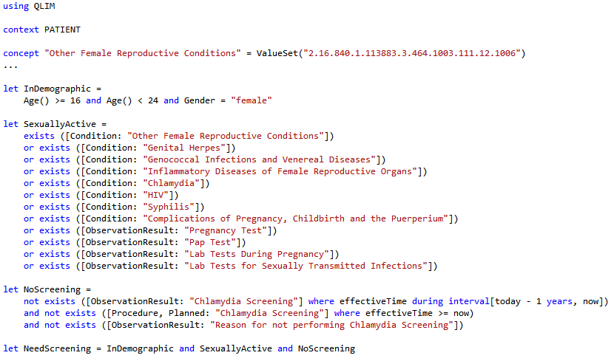
CQL Allows Systems to Act on Clinical Data Chlamydia Screening, CDS

Slide 10
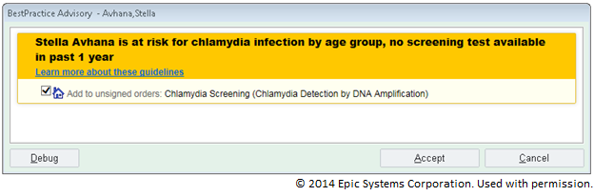






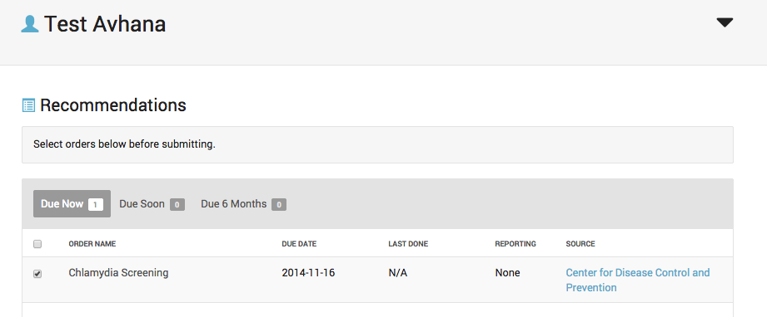
CQF Pilots Chlamydia Screening
Chlamydia Screening Rule
in
KAS + CQL + QUICK
CQF Wiki: cqframework.info 18
Notes:
Primary objectives: validate use of FHIR as messaging model using “man in the middle” approach; advance the HL7 Conformance Testing Program by automating and executing test cases
A FHIR Profile will be developed which is aligned with QUICK.
Develop the man-in-the middle transformation software. FHIR messages are transformed to vMR and submitted to the ICE service; response from ICE is relayed back to the client.
Modify the HTML5 client (previous page) to accept a FHIR immunization forecasting request conforming to the FHIR profile defined during this project, and receive FHIR responses from the service.
Modify the immunization forecasting tester used by Texas Children’s Hospital (TCH) to submit test cases based on FHIR
Utilize AEGIS Developers Integration Lab software to advance the HL7 Conformance Testing Program by automating and executing test cases for immunization forecasting. (See http://www.hl7.org/implement/conformanceTesting.cfm)
2) Secondary objectives(resources permitting):
- update underlying data model for knowledge authoring and knowledge execution to use QUICK (vs. vMR) and potentially CQL

Slide 11
CQF: Unique Contributions
History of successful harmonization
Flexible, model-agnostic expression language allows use of models to drive action
Existing approach towards model convergence
Deep integration with FHIR and effort to incorporate into the core standard

Slide 12
Joint FHIR Profiles for Quality
QUICK (CQF)
DAF
CIMI/HSPC
QI Core
Notes:
QUICK data model will be generated automatically directly from the complete FHIR profiles for Quality
Goal is to facilitate a transition between existing standards and future standards through modularity
Ongoing pilots will demonstrate implementation feasibility and lead to further standards refinement
Collaboration with CIMI and DAF to define common extensions where overlaps occur. Ensure QICore, DAF, CIMI FHIR profiles are compatible and share common elements rather than each define them separately.

Slide 13
Moving Towards a Unified Clinical Data Model in FHIR
Approach of “progressive convergence”– started with models that have overlap (i.e. DAF/CQF are based on federal programs) or common interest/goals (CIMI seeks to describe sophisticated clinical data for patient care)
Desire to collaborate and potential to share level of effort is major benefit of this approach
Making concrete progress within reasonable timeframes is critically important (thus a staged approach may be needed)

Slide 14
Current Unified Model Approach
QUICK (CQF)
DAF
CIMI/HSPC
FHIM
QI Core

Slide 15
Moving Towards a Unified Clinical Data Model in FHIR
Over time, greater convergence creates a case on its own for wider use and more shareablity
Shared efforts lead to greater efficiencies over time
Need to share ownership and give up the “but we’re special” mindset
To transform a large community (e.g. FHIR) it takes a large community!

Slide 16
CQF: Unique Contributions
History of successful harmonization
Flexible, model-agnostic expression language allows use of models to drive action
Existing approach towards model convergence
Deep integration with FHIR and effort to incorporate into the core standard

Slide 17
FHIR Does NOT Guarantee Semantic Interoperability
While FHIR creates more opportunities for technical interoperability, the use of layered profiles and extensions leads to disparate representations of identically named or defined content–> guaranteed conformance problems
The lack of integration testing and tooling means there is no end in sight to the extent of these problems (and they will continue to get worse)
One approach to countering this problem is a unified clinical data model to ensure the same content has the same meaning

Slide 18
The Gap Between FHIR and the Clinical “Real World”
Initially clinicians struggled to get their voices heard in FHIR
Bringing critical clinical content into FHIR core allows improved overlap in the ovals
For FHIR to successfully support the Learning Health System, it needs to support the point of care and downstream
The Engineer’s 80%
The Clinician’s 80%

Slide 19
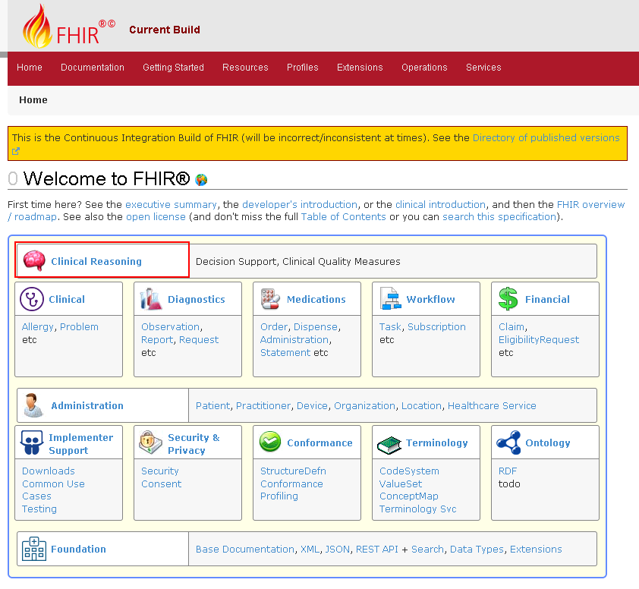
CQF FHIR IG: Successful Deep Integration into FHIR
IG supports
CDS knowledge artifacts (rules, order sets, documentation templates)
Quality measures
Service-based evaluation
http://hl7-fhir.github.io/clinicalreasoning-module.html

Slide 20
Where Are We Headed
September ballot cycle reflects a major achievement towards a stable, implementable method to achieve decision support and quality measurement
CQF desires ongoing convergence to a sustainable, expressive standard that supports clinical workflow and direct patient care activities
Focus on functionality and usability
Integration with federal programs, broad vendor systems
Common data definitions to ensure data validity

Slide 21
What Remains to be Done
We need to keep nurturing this alignment and ultimate convergence on a common logical model– i.e. this meeting and a concrete plan!
CQF needs to enhance the expressivity of CIMI to capture, at the very least, the requirements of the QDM, vMR, and FHIM
CIMI needs to offer a way to crowd-source and accelerate the creation of more detailed archetypes based on the core archetypes that the collaborative group will initially define

Slide 22
What Remains to be Done Make it Tangible
Pilots to:
Generate FHIR profiles from CIMI archetypes
Transform FHIR instance to a logical representation of the data for rule engines, measure engines, and back?
Demonstrate defined archetypes are clinically relevant and useful
Show that vendors can manipulate FHIR data conformant to these profiles - could be staged over time (e.g., from DAF compliance through specific CIMI archetypes and work your way outward)

Slide 23
What the Role of CQF Can and Should Be
Offers an excellent expression language (CQL) not constrained by the data model
CQL is being adopted broadly in FHIR and outside of it
Has and will continue to bring significant clinical content into FHIR core
Can help foster alignment and reuse in federal programs
Offers implementation guides that allow immediate implementation of standards-based content into clinical settings including through clinical decision support and clinical quality measures

Slide 24
Conclusions
Using a harmonized approach, data reuse becomes infinitely more possible
Only through ongoing engagement across stakeholders will we enable a Learning Health System
Need to be willing to give up something to make big gains
The approach outlined here is exciting and CQF is all in!
Contact: Julia Skapik, julia.skapik@hhs.gov

Slide 25
Links to Additional Information
QUICK Logical Model
https://github.com/cqframework/OneModel/blob/master/QUICK/eap/QUICK.eap
QICore FHIR Profiles (in ballot)
http://hl7.org/fhir/qicore/qicore.html
CQF on FHIR Implementation Guide (in ballot)
http://hl7-fhir.github.io/clinicalreasoning-module.html

Slide 26
Appendix: Thoughts
CDS and CQI needs to operate on real, existing data – there must be a balance between ideal future information models and current models
Convergence makes a lot of sense provided there is true agreement to converge (rather than for others to simply accept one’s own approach)
Fragmentation of models and ultimately profiles will impose a significant burden to developers and result in higher long term integration costs - lots of transformations, loss of data, etc...
QICore and DAF were a step in the right direction but then all must be kept in sync. It is not easy as we found out. Add SDC, CIMI, HSPC, FHIM, registries, etc... and “synching” becomes nightmarish.
QUICK (the harmonization of QDM and vMR) was also an important step in the alignment of a logical representation of clinical data but was difficult to scale (as we learned building templates). Then, there are other models too like FHIM, OpenEHR, etc.... We needed to converge these models and CIMI appeared to be an ideal opportunity to do so. Through CIMI preferred archetypes, we can generate a single set of profiles that harmonizes our requirements. No need to manually keep models in sync. We also get the formal model behind the FHIR profiles.

